Slide 1

STUDENT SKILL EXCHANGE PLATFORM USING MACHINE LEARNING
Team Members:
Member-1:CH.V.V.Vinay(23395-CM-009)
Member-2:D.Sai Thanuja(23395-CM-013)
Member-3:G.Venu Sankar(23395-CM-018)
Member-4:K.Mahima Jyothi(23395-CM-023)
Member-5:Jagan Mohan(23395-CM-032)
Member-6:P.Sai(23395-CM-044)
Member-7:R.Rechal Kusuma(23395-CM-052)
Guide Name: CH. Gopal Krishna

Slide 2
CONTENTS
Introduction
Project Overview
Problem Statement
Objectives
Literature Survey
Limitations of Existing Approaches
Proposed System
System Architecture
Step-by-Step Working
Algorithm Used
Tools & Technologies
Results
Advantages and Disadvantages
Future Scope
Conclusion

Slide 3
INTRODUCTION
In many colleges, students have different skills like programming, design, communication, and technical knowledge. However, some students have hesitation and fear of judgment, so they do not express their skills or ask doubts in class. Because of this, their academic progress may reduce. At the same time, faculty members cannot give personal attention to every student due to large class sizes and limited time.
To solve this problem, we developed a Student Skill Exchange Platform using Machine Learning. This system intelligently matches students based on their skills and interests, helping them learn from each other in a comfortable and supportive environment. It also provides a secure chat feature so students can communicate and clarify doubts without fear

Slide 4
PROJECT OVERVIEW
This project is a web-based application developed using Python, SQLite database, Machine Learning, and a Gradio interface. It is designed to help students connect with each other based on their skills. The system allows students to create profiles, store their skills in a database, and search for other students who have similar or required skills.
The platform also uses Machine Learning techniques like TF-IDF and Cosine Similarity to provide intelligent skill matching with confidence scores. In addition to matching, the system includes a secure chat feature for communication and a dashboard to display statistics such as total users and model accuracy. The main goal of this project is to encourage peer-to-peer learning through smart and automated matching.

Slide 5
PROBLEM STATEMENT
In many educational institutions, students face difficulties in clarifying their academic doubts effectively. Although classrooms are designed for learning, not every student feels comfortable asking questions openly. Some students hesitate due to fear of judgment from classmates, lack of confidence, or anxiety about speaking in public. This hesitation often prevents them from clearing their misunderstandings at the right time.
At the same time, faculty members have limited availability. They must manage multiple classes, administrative duties, and personal responsibilities. Because of time constraints, they cannot always provide individual attention to every student. As a result, students who require extra explanation or personalized guidance may not receive sufficient support.
Additionally, there is often limited structured interaction between students for academic collaboration. Even though many students possess strong knowledge or skills in certain subjects, there is no organized system within institutions that connects learners with peers who can help them. Knowledge sharing remains informal and unstructured, which reduces its effectiveness.

Slide 6
Due to these barriers hesitation, fear of judgment, limited faculty time, lack of structured peer interaction, and communication gaps students may struggle to learn concepts deeply. This slows down their academic progress and reduces their overall confidence.
Therefore, there is a need for an intelligent, structured, and student-centered platform that enables peer-to-peer skill exchange. Such a system should connect students based on their skills and learning needs in a comfortable and supportive environment, helping to remove hesitation and promote collaborative learning.

Slide 7
LITERATURE SURVEY
1.BERT-Based Hybrid Recommendation System (2024)
This research combines TF-IDF and BERT embeddings for academic profile matching. It improves recommendation accuracy by understanding contextual meaning. However, it requires high computational power.
2. Content-Based Recommendation using TF-IDF & Cosine Similarity
This approach uses TF-IDF and Cosine Similarity to match user profiles. It is efficient and widely used for text-based systems. However, it cannot capture deep semantic meaning.
3. Student-Event Recommendation System (2017)
This system matches students with college events using text mining and similarity measures. It improves relevance but focuses only on event recommendations, not peer skill exchange.
4. Collaborative Filtering for Peer Matching
Collaborative filtering connects users based on similar interests. It is useful for peer learning platforms but has a cold-start problem for new users.
5. Content-Based Recommendation Systems (2007)
This method compares user profiles using text mining techniques like TF-IDF. It works well for profile matching but lacks collaborative insights.

Slide 8
OBJECTIVES
To create a platform where students can share and exchange their skills
To help students overcome hesitation and fear of judgment
To provide an opportunity for students to ask doubts freely
To support students whose academic progress is affected due to lack of interaction
To reduce dependency only on faculty by encouraging peer learning
To implement skill matching using Machine Learning
To enable secure communication between students
To evaluate the system performance using accuracy metrics

Slide 9
LIMITATIONS OF EXISTING APPROACHES
Manual skill searching
No ML-based recommendation system
No real-time peer interaction
No accuracy evaluation
No centralized student skill database
Limited communication between students
Reduces collaboration and skill visibility

Slide 10
PROPOSED SYSTEM
Users create profiles and enter their skills as input
Student data is stored in a centralized SQLite database
Skill text is converted into numerical format using TF-IDF
Cosine Similarity is used to calculate similarity between students
The ML model identifies and displays Top-K similar users
Confidence scores (%) are shown to indicate matching strength
Secure chat system enables peer-to-peer communication
Message history is stored and managed in the database
Dashboard displays total users, unique skills, and Top-3 accuracy
System performance is evaluated using accuracy metrics
Acts as a smart learning support platform that promotes peer-to-peer collaboration

Slide 11
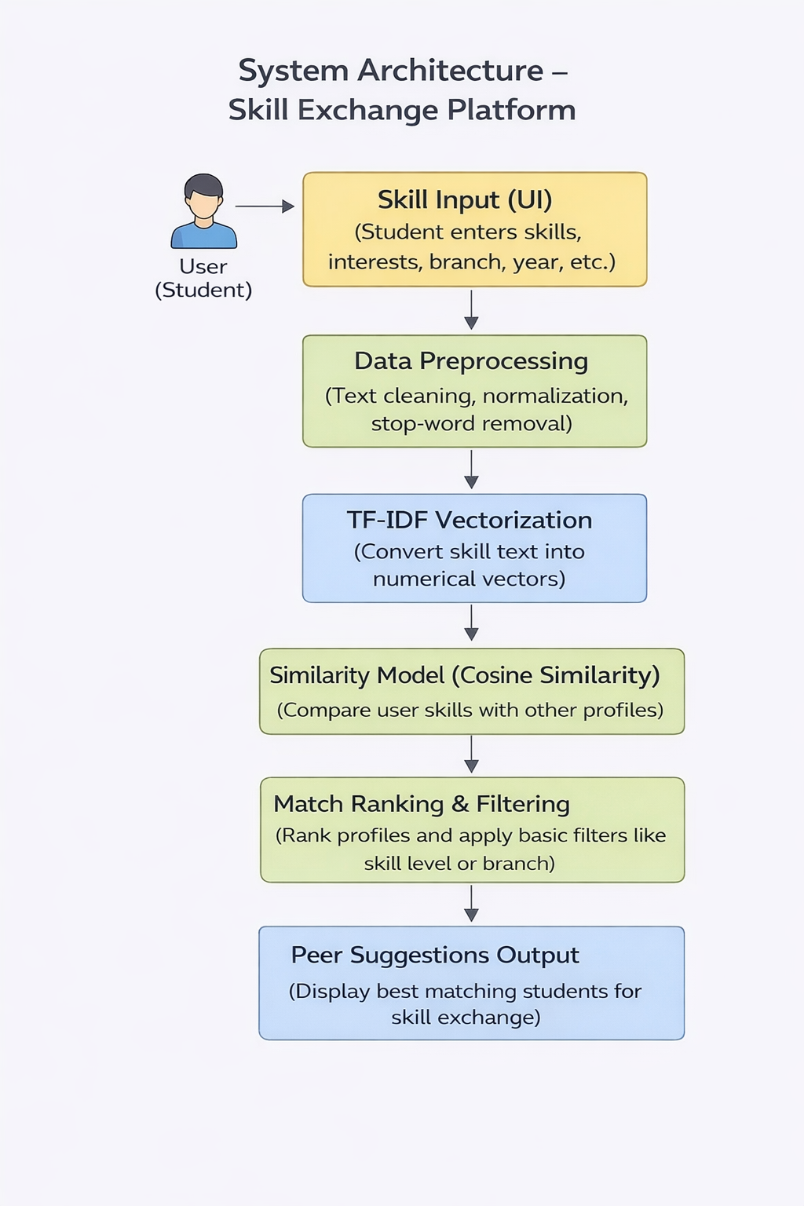
SYSTEM ARCHITECTURE

Slide 12
STEP-BY-STEP WORKING
User creates profile (Name, Email, Skills).
Data is stored in SQLite database.
User enters skills for matching.
TF-IDF converts text skills into vectors.
Cosine Similarity calculates similarity between users.
Top 5 similar users are displayed with confidence scores.
Users can send messages through Chat module.
Dashboard shows statistics and model accuracy.

Slide 13
TOOLS &TECHNOLOGIES USED
Platform
Google Colab:Used as an online platform to develop and run the Python code.
Frontend
Gradio Interface:Used to create a simple user interface for entering skills and displaying recommendations.
Backend
Python:Main programming language used to implement the system logic.
NumPy: Used for numerical computations
Pandas: Used for data handling and preprocessing
Scikit-learn:Used to implement machine learning techniques.

Slide 14
Algorithms
TF-IDF :Used to convert skill text into numerical vectors.
Cosine Similarity: Used to measure similarity between student skills and generate recommendations.
Database
SQLite:Used to store and manage student skill data.
Hardware Requirements
Standard Laptop or Desktop
Minimum 4 GB RAM
Required for running the project in Google Colab and accessing libraries.

Slide 15
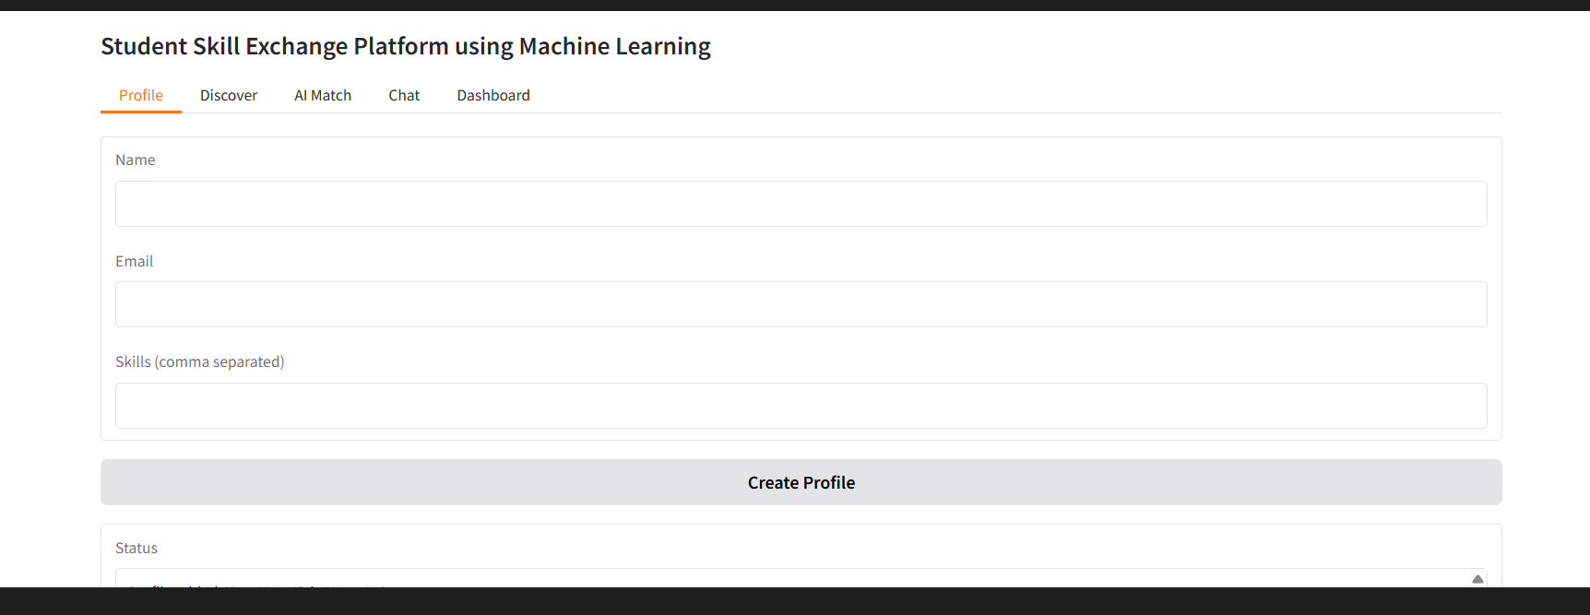
RESULTS
Profile Input Screen:
This screen allows the user to enter their profile details and skills.

Slide 16
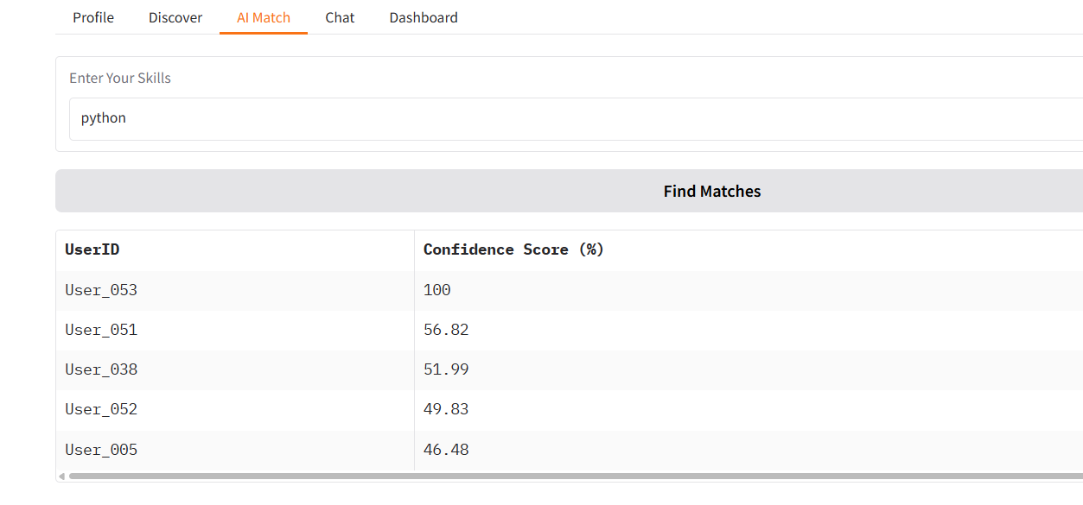
Match Results:
The system recommends students with similar skills and shows their similarity score.

Slide 17
ADVANTAGES
Reduces hesitation and fear of asking doubts
Encourages peer-to-peer collaborative learning
Utilizes student knowledge effectively
Intelligent and accurate skill matching using ML
User friendly interface
Lightweight and simple database system
Cost-effective solution (no heavy infrastructure required)
Promotes confidence and communication among students

Slide 18
DISADVANTAGES
Depends heavily on active student participation
Requires internet connection to access the platform
No advanced authentication mechanism in current version
The quality of recommendations depends on how clearly users describe their skills.
No offline mode.

Slide 19
FUTURE SCOPE
Advanced Machine Learning Algorithms
Mobile Application Development
Real-time notification system
Admin monitoring dashboard
Deep Learning recommendation system
Cloud-based database
Multi-language support
Performance analytics tracking

Slide 20
CONCLUSION
The Student Skill Exchange Platform provides an effective way for students to connect with others who have similar skills and learning interests. By using machine learning techniques such as TF-IDF and Cosine Similarity, the system analyzes student skill data and generates relevant recommendations. This helps students find suitable peers for collaboration, knowledge sharing, and skill development. The platform demonstrates how technology and machine learning can support student learning communities and improve interaction among students. In the future, the system can be enhanced with additional features to make the platform more interactive and efficient.

Slide 21
THANK YOU

